Slide 1
Chapter 6
Health and Wellness Food and Beverages in Food Service, Hospitality and Tourism
Dr. Bendegul Okumus
Heather Linton Kelly

Slide 2
Learning Outcomes
Discuss the case study of The Smoothie Industry
Define the concept of health and wellness food and beverages
Explain the market value of health and wellness food and beverage market in the US and globally
Identify and explain several healthy food and beverage trends
Discuss how healthy/wellness food and beverages can be combined with other wellness activities
Offer suggestions on how foodservice, hospitality, and tourism businesses can utilize health and wellness food and beverage trends in their business operations

Slide 3
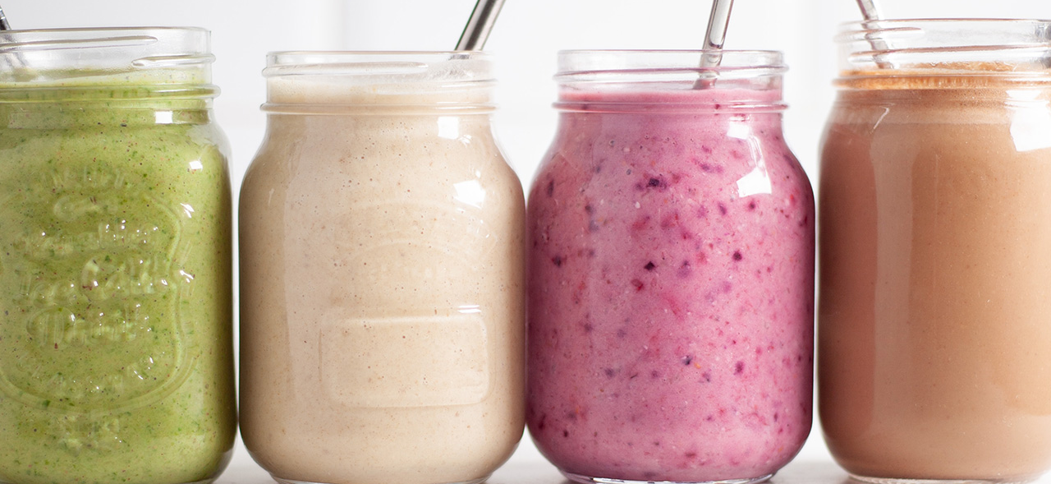
Case Study: The Smoothie Industry

Slide 4
The Concept and Scope of Health & Wellness Food & Beverages
Food and beverages in the health and wellness industry are specifically formulated to provide nutritional, health, and functional benefits to consumers
The health and wellness food market was valued at $707 billion USD in 2016, and is estimated to be worth $812 billion USD in 2021

Slide 5
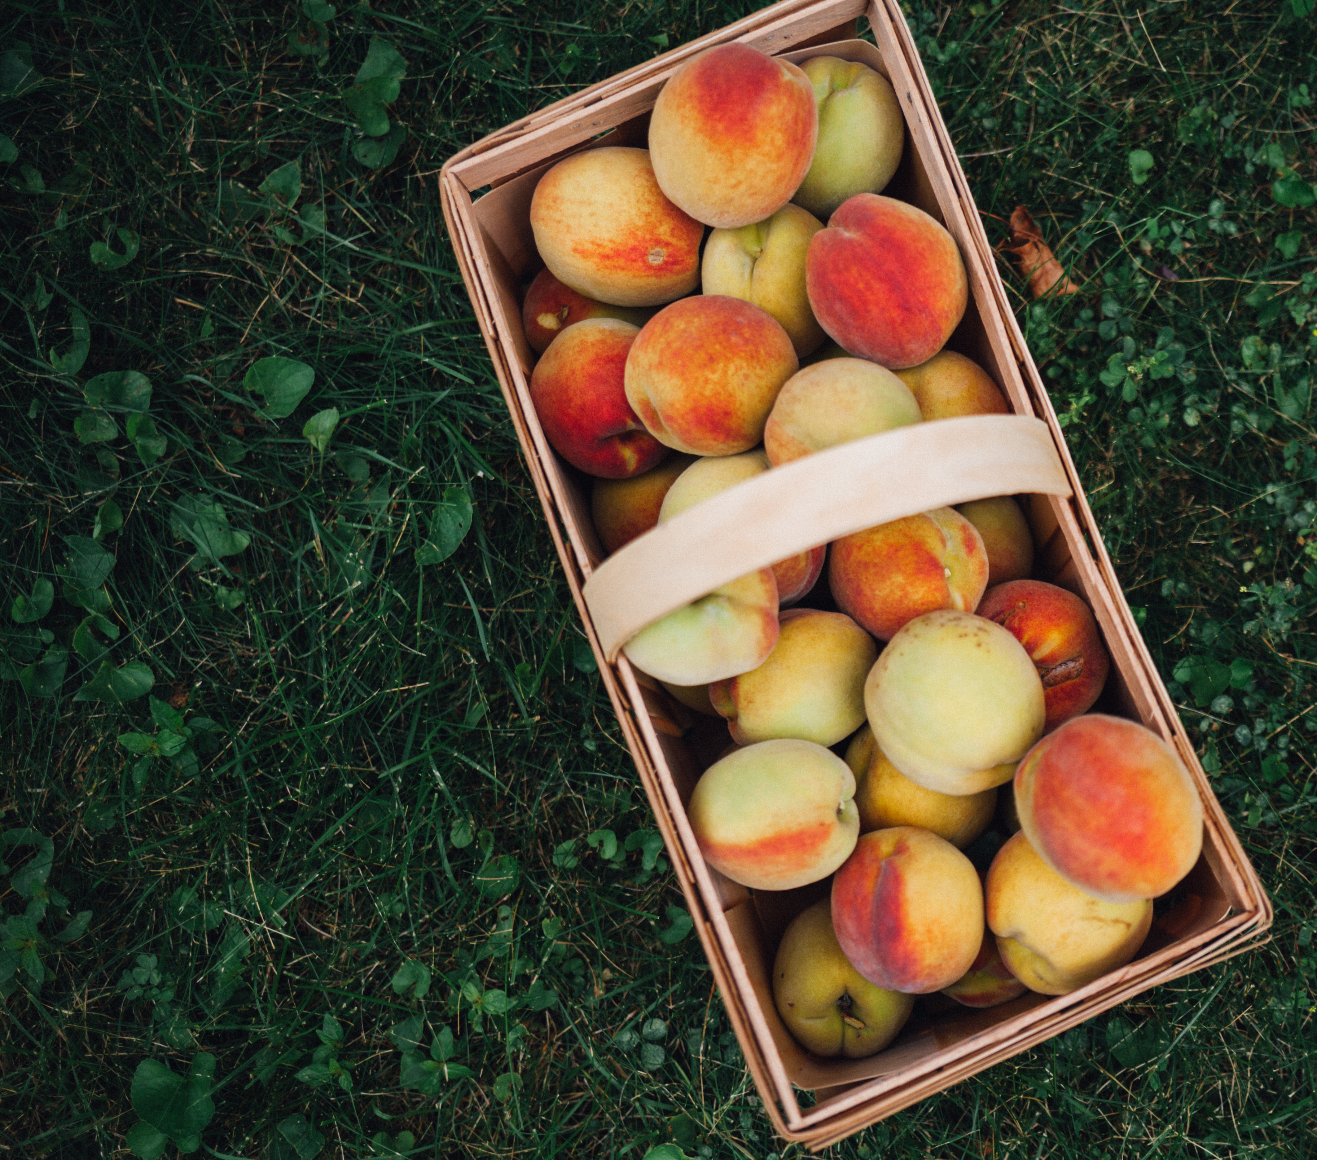
Health and Wellness Food and Beverage Trends
Farm-to-Table/Locally Sourced
  Food security
  Proximity
  Self-reliance
  Sustainability

Slide 6
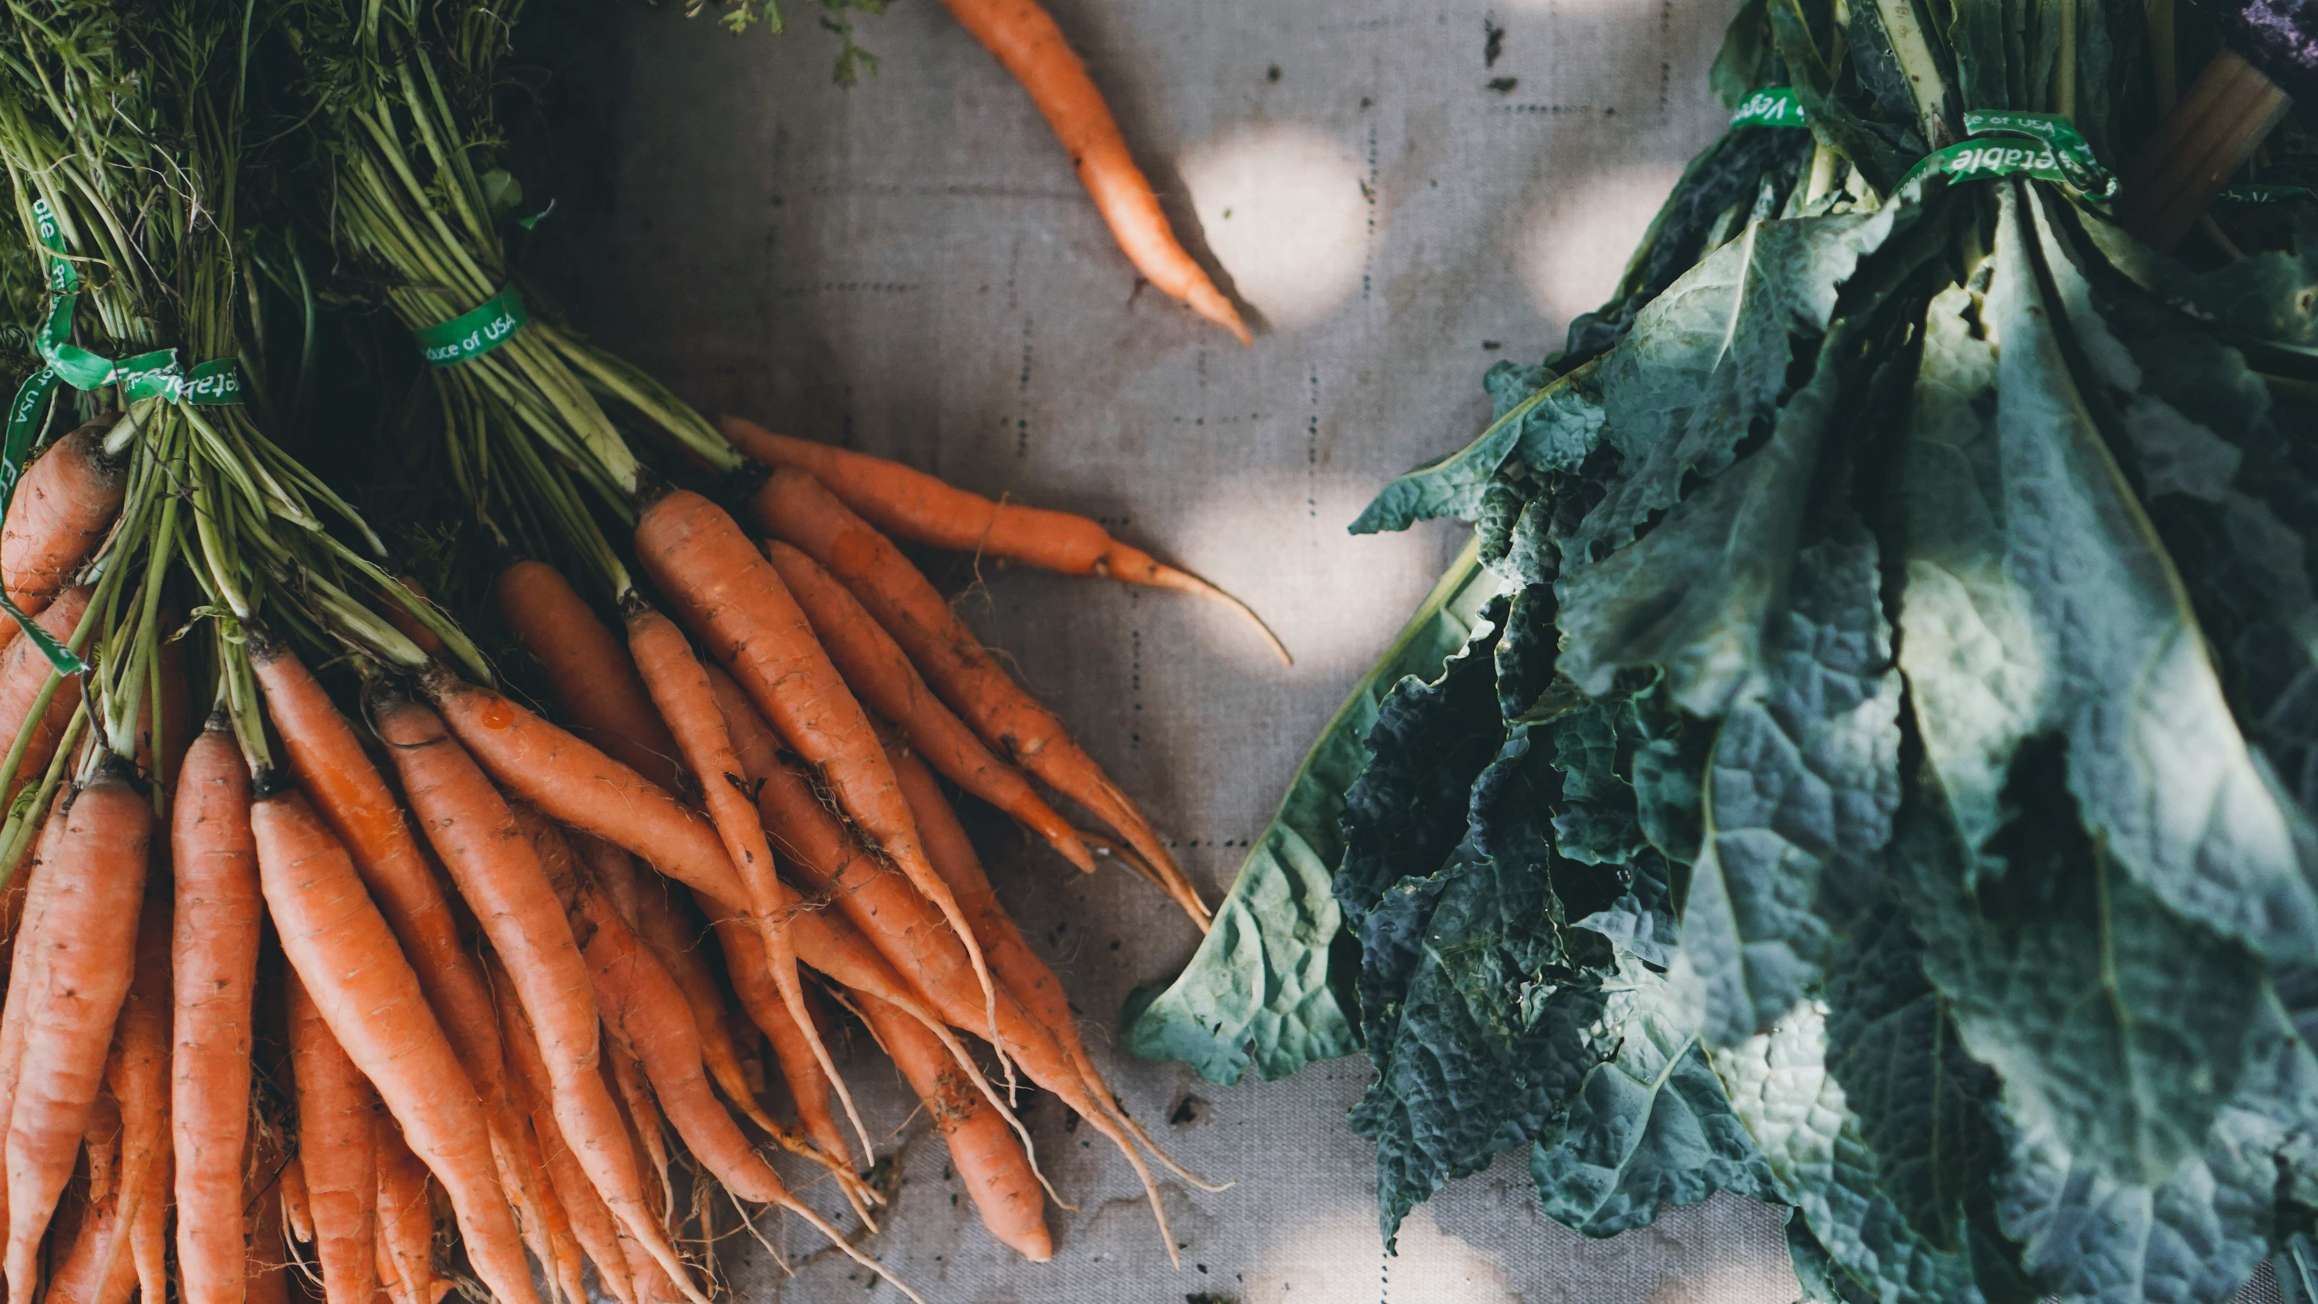
Health and Wellness Food and Beverage Trends
Organic: Food grown without toxic and synthetic pesticides or fertilizers; GMO ingredients; antibiotics or synthetic growth hormones; artificial flavors, colors, or preservatives; and sewage sludge or irradiation

Slide 7
Health and Wellness Food and Beverage Trends
Limited-Ingredient Diets
  Paleo: A diet based on foods that in the past could be obtained through hunting and gathering during the Paleolithic era (2.5 million to 10,000 years ago), such as fruits, vegetables, fish, lean meats, nuts and seeds
  Pescatarianism: A diet consisting of no meat other than seafood
  Veganism: A diet consisting of no animal products
  Vegetarianism: A diet consisting of no meat
Plant-Based Diets
  Some strict plant-based diets are similar to veganism, with no consumption of any animal products allowed
  Others are centered around plants but focus on whole foods and healthy fats and allow animal products such as fish, limited dairy, and poultry

Slide 8

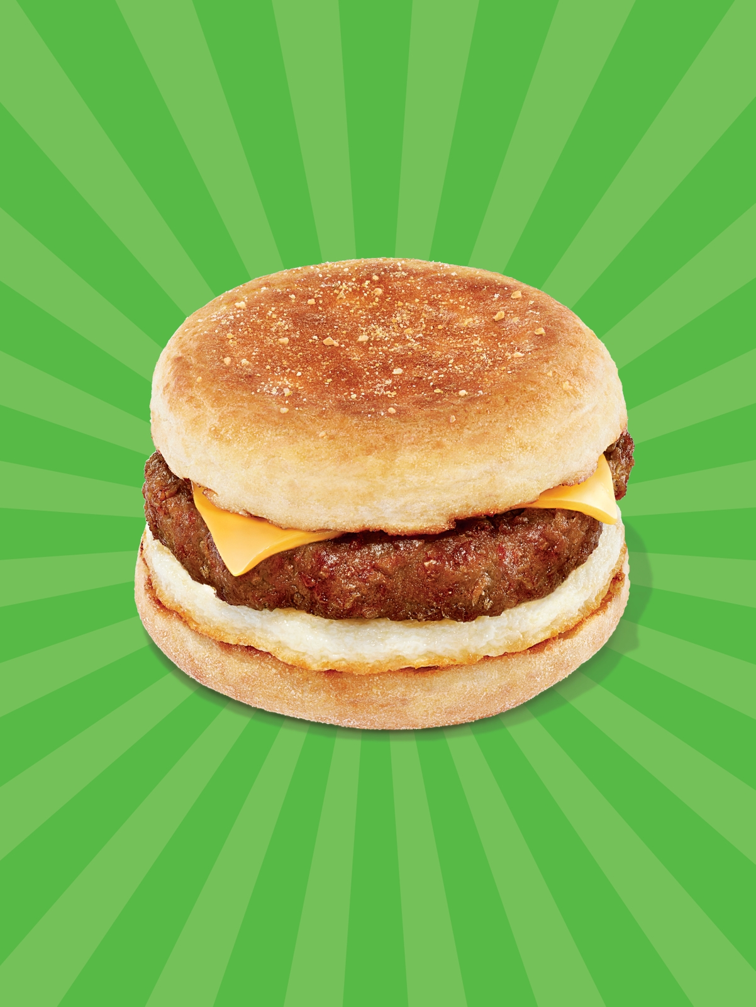
Health and Wellness Food and Beverage Trends
Burger King’s Impossible Whopper
Dunkin’s Beyond Breakfast Sandwich

Slide 9
Health and Wellness Food and Beverage Trends
Immersive and Sensory Food Experiences
  Food festivals
  Fusion of art and cuisine
  VR and AR
Eating for Happiness
  Serotonin is synthesized from the amino acid tryptophan, found in such foods as eggs, cheese, pineapples, tofu, salmon, nuts and seeds, and turkey
  Ingredients such as avocado, quinoa and raw honey that may lower the risk of Alzheimer’s disease and offer other brain-healthy benefits

Slide 10
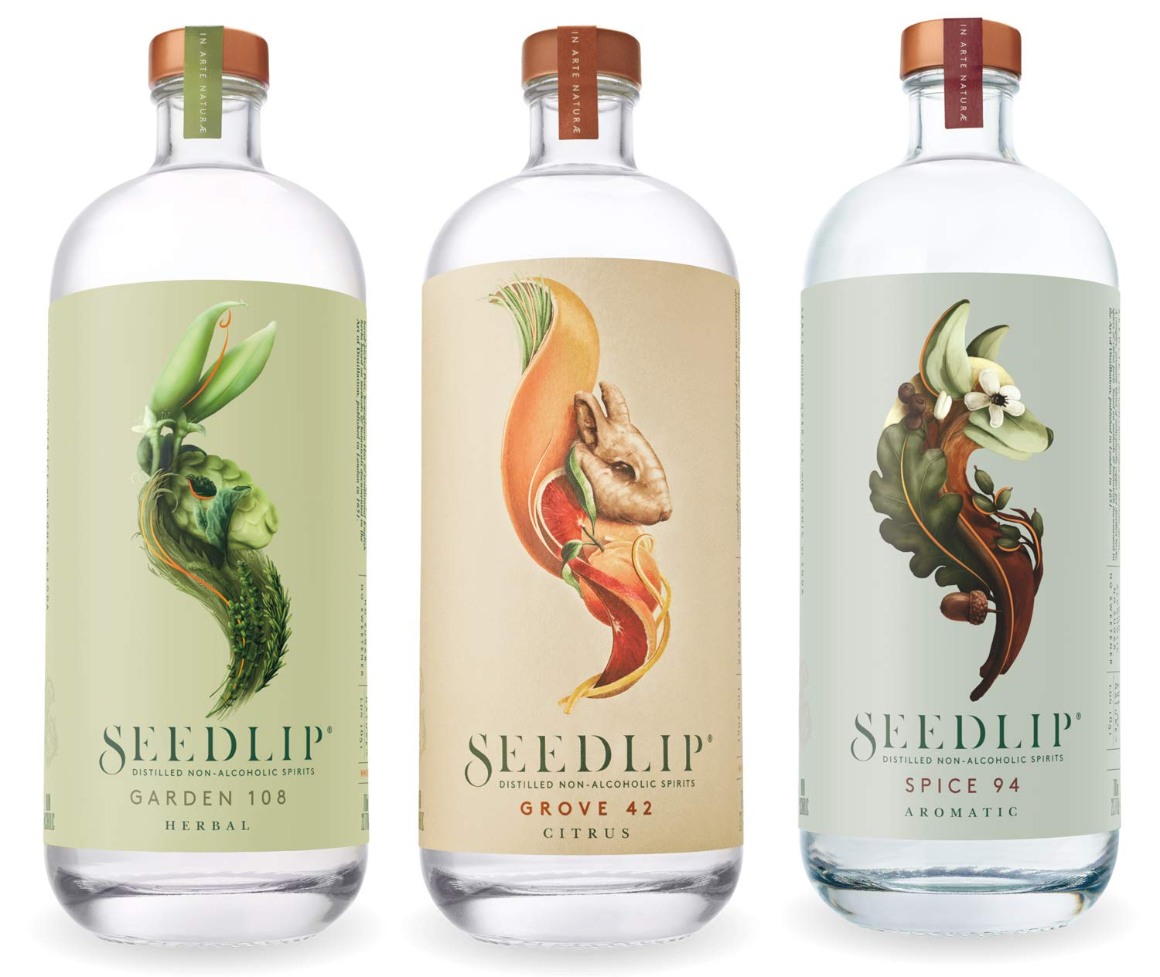
Health and Wellness Food and Beverage Trends
Healthy Beverages
  Fruit smoothies, cold-pressed juices, non-alcoholic ‘health elixirs’
  Alcoholic beverages incorporating vegetable juices
Use of Technology
  “Smart diet” concept will enable consumers to track their activity and calorie intake, and completely customize and individualize their approach to physical and mental health
  Agricultural innovations
  Ghost/cloud kitchens for food delivery services

Slide 11
The Kitchen: Reimagined
CONVENTIONAL | vs. | WELLNESS
Ingredients and prepared food comes in paper, aluminum, and plastic bags, jugs, boxes and cans. These can leach into food that is full of preservatives, and additive ingredients. | Delivery | Fresh food is harvested from in-home gardens, and unprocessed local ingredients and bulk items are available and delivery may be automated.
‘Dead’ food is stored in freezing/near freezing temperatures or at warm room temperatures behind doors and easily forgotten about for long periods of time. | Storage | ‘Living’ food is kept alive or dormant in a range of appropriately temperature and humidity controlled environments with transparent display doors.
Packaging from pre-made and pre-mixed food is recycled or thrown away. | Preparation | Fresh food reduces the need for packaging. Preparation spaces have multiple work stations and allow for easy clean up.

Slide 12
The Kitchen: Reimagined
CONVENTIONAL | vs. | WELLNESS
Microwaves thaw, cook, and reheat main dishes. Stoves and ovens are meant to cook food quickly at high temperatures. | Cooking | Food is cooked using a range of temperatures and a variety of sources to maintain nutrients and enhance natural flavors.
A lot of bulky packaging is needed, and only some of it is recyclable. The rest is sent to landfills. | Disposal | Unpackaged, fresh food and reusable containers reduce trash, and compost collection returns organic matter to the soil.
Fast, unconscious eating habits increase food proportions. Food is lacking in nutrients, and unhealthy additives allow for convenience and a long shelf life. | Consumption | Visible storage of healthy and fresh food is tempting, food preparation is conscious, and mindful consumption helps regulate proportions.
Food is prepared in isolation before serving the dishes in a separate space. | Social Activity | The kitchen is the heart of the home, designed for gathering, entertaining, and nourishing.

Slide 13
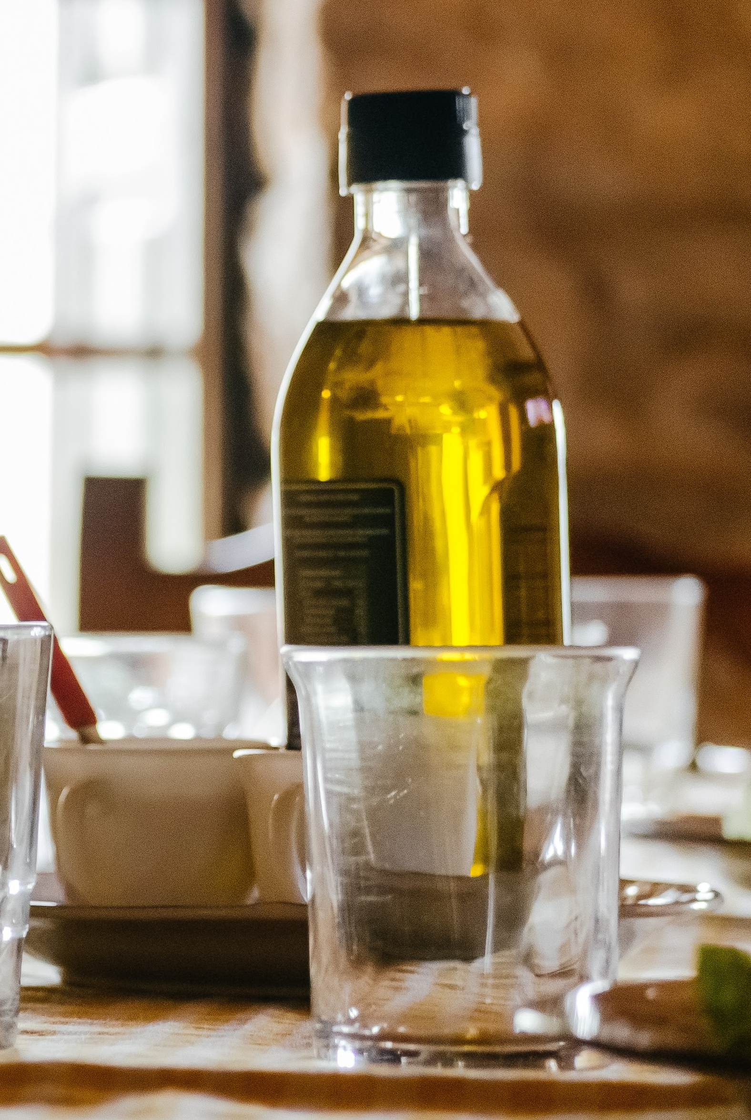
Health and Wellness Food and Beverage Trends
Slow Food Restaurants
  Inspired by Mediterranean culture
  Focuses on enjoying food, not eating it as quick as possible
Functional Foods
  Has the following traits:
    Health benefits - should enhance the target function or help to prevent the disease occurrence
    Nature of food – remain as traditional food
    Level of function – beyond its basic nutritional function
    Consumption pattern – per normal routine diet

Slide 14
Combining Health and Wellness Foods and Beverages with other Wellness Activities
People want to consume ingredients and products that align with their overall health and fitness goals
Beyond simply losing weight and looking good, they want to embrace personal responsibility and feel good
Traditional wellness ingredients are being incorporated into consumers’ diets
Food movements like farm-to-table are re-centering the focus on local communities
Wellness retreats often integrate a healthy diet

Slide 15
Summary
The Smoothie industry is growing 7% a year and smoothies are seen as a good source of fiber and other nutrients.
One major health and wellness food and beverage trend is farm to table or locally sourced products. This is where products are grown locally and brought straight to the market where the community can purchase them.
The four principles of the farm to table concept are: food security, proximity, self-reliance, and sustainability.
Another major health and wellness food and beverage trend is organic food.

Slide 16
Summary
Limited ingredient diets like vegetarian, vegan, pescatarian, and paleo are also another food and beverage trend in health and wellness.
Vegetarian, vegan, and pescatarian are similar in that the limit the amount of animal products a person consumes.
More recently, immersive and sensory food experiences through the use of AR and VR have become popular.

Slide 17
Summary
Other trends include eating for happiness, healthy beverages, the use of technology, slow food restaurants, and functional foods.
Lastly, the kitchen has been reimagined in the following ways to focus more on health and wellness: delivery, storage, preparation, cooking, disposal, consumption, and social activity.
List five interesting things you have learned during this week

